Slide 1
Node js
k. Anju Munoth

Slide 2
Node.js
Cross-platform runtime environment and library for running JavaScript applications outside the browser.
Used for creating server-side and networking web applications.
Open source and free to use.
Many of the basic modules of Node.js are written in JavaScript.
Node.js is mostly used to run real-time server applications.
Also provides a rich library of various JavaScript modules to simplify the development of web applications.

Slide 3
Node js
Definition given by its official documentation:
Node.js is a platform built on Chrome's JavaScript runtime for easily building fast and scalable network applications. Node.js uses an event-driven, non-blocking I/O model that makes it lightweight and efficient, perfect for data-intensive real-time applications that run across distributed devices.

Slide 4
Features of Node.js
Extremely fast: Node.js is built on Google Chrome's V8 JavaScript Engine, so its library is very fast in code execution.
I/O is Asynchronous and Event Driven: -All APIs of Node.js library are asynchronous i.e. non-blocking.
Node.js based server never waits for an API to return data. The server moves to the next API after calling it and a notification mechanism of Events of Node.js helps the server to get a response from the previous API call.
Single threaded: Node.js follows a single threaded model with event looping.

Slide 5
Features of Node.js
Highly Scalable: event mechanism helps the server to respond in a non-blocking way.
No buffering: Cuts down the overall processing time while uploading audio and video files.
Applications never buffer any data. Applications simply output the data in chunks.
Open source: Node.js has an open source community which has produced many excellent modules to add additional capabilities to Node.js applications.
License: Node.js is released under the MIT license.

Slide 6
Features of Node.js
Over the years, most of the applications were based on a stateless request-response framework.
In these sort of applications, it is up to the developer to ensure the right code was put in place to ensure the state of web session was maintained while the user was working with the system.
But with Node.js web applications, can now work in real-time and have a 2-way communication.
The state is maintained, and the either the client or server can start the communication.

Slide 7
Who uses Node.js
Node.js is used by a variety of large companies. Below is a list of a few of them.
Paypal – A lot of sites within Paypal have also started the transition onto Node.js.
LinkedIn - LinkedIn is using Node.js to power their Mobile Servers, which powers the iPhone, Android, and Mobile Web products.
Mozilla has implemented Node.js to support browser APIs which has half a billion installs.
Ebay hosts their HTTP API service in Node.js

Slide 8
When to Use Node.js
Node.js is best for usage in streaming or event-based real-time applications like
Chat applications
Game servers – Fast and high-performance servers that need to processes thousands of requests at a time, then this is an ideal framework.
Good for collaborative environment – This is good for environments which manage document. In document management environment you will have multiple people who post their documents and do constant changes by checking out and checking in documents. So Node.js is good for these environments because the event loop in Node.js can be triggered whenever documents are changed in a document managed environment.
Advertisement servers – Again here you could have thousands of request to pull advertisements from the central server and Node.js can be an ideal framework to handle this.
Streaming servers – Another ideal scenario to use Node is for multimedia streaming servers wherein clients have request's to pull different multimedia contents from this server.
Node.js is good when you need high levels of concurrency but less amount of dedicated CPU time

Slide 9
When to not use Node.js
Node.js can be used for a lot of applications with various purpose, the only scenario where it should not be used is if there are long processing times which is required by the application.
Node is structured to be single threaded.
If any application is required to carry out some long running calculations in the background.
So if the server is doing some calculation, it won't be able to process any other requests.
Node.js is best when processing needs less dedicated CPU time.

Slide 10
Asynchronous event driven IO helps concurrent request handling
If a request is received by Node for some Input/Output operation, it will execute the operation in the background and continue with processing other requests.
This is quite different from other programming languages.
A simple example of this is given in the code below
var fs = require('fs');
fs.readFile("Sample.txt",function(error,data)
{
console.log("Reading Data completed");
});

Slide 11
Asynchronous event driven IO helps concurrent request handling
Code snippet looks at reading a file called Sample.txt.
In other programming languages, the next line of processing would only happen once the entire file is read.
But in the case of Node.js the important fraction of code to notice is the declaration of the function ('function(error,data)'). This is known as a callback function.
So what happens here is that the file reading operation will start in the background.
And other processing can happen simultaneously while the file is being read.
Once the file read operation is completed, this anonymous function will be called and the text "Reading Data completed" will be written to the console log.

Slide 12
Traditional Web Server Model
In the traditional web server model, each request is handled by a dedicated thread from the thread pool.
If no thread is available in the thread pool at any point of time then the request waits till the next available thread.
Dedicated thread executes a particular request and does not return to thread pool until it completes the execution and returns a response.

Slide 13
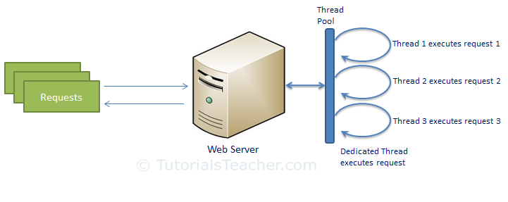
Traditional Web Server Model

Slide 14
Node.js Process Model
Node.js processes user requests differently when compared to a traditional web server model.
Runs in a single process and the application code runs in a single thread and thereby needs less resources than other platforms.
All the user requests to your web application will be handled by a single thread and all the I/O work or long running job is performed asynchronously for a particular request.
So, this single thread doesn't have to wait for the request to complete and is free to handle the next request.
When asynchronous I/O work completes then it processes the request further and sends the response.

Slide 15
Node.js Process Model
An event loop is constantly watching for the events to be raised for an asynchronous job and executing callback function when the job completes.
Internally, Node.js uses libev for the event loop which in turn uses internal C++ thread pool to provide asynchronous I/O.
Every time an expensive operation occurs, we pass a callback function that will be called once we can continue with the processing. We’re not waiting for that to finish before going on with the rest of the program.

Slide 16
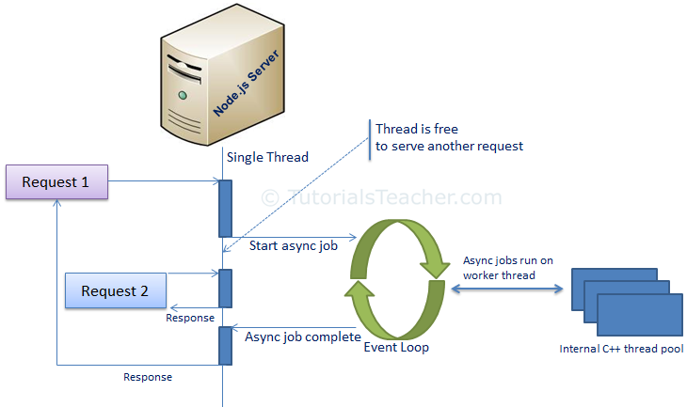

Slide 17
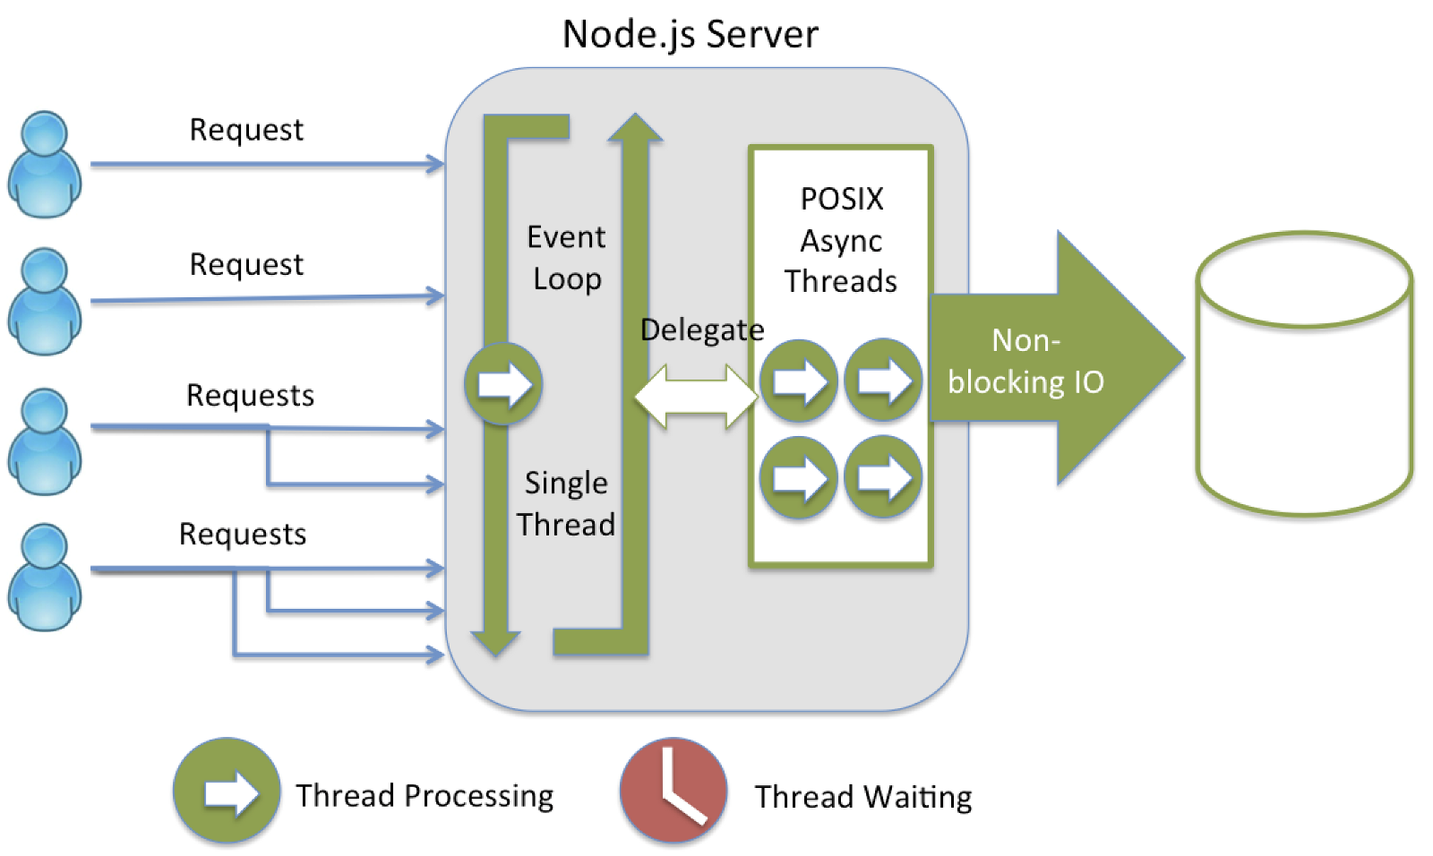

Slide 18
Node.js Process Model
Node.js process model increases the performance and scalability with a few caveats.
Node.js is not fit for an application which performs CPU-intensive operations like image processing or other heavy computation work because it takes time to process a request and thereby blocks the single thread.

Slide 19
Non blocking I/O
Node provides non-blocking I/O primitives, and generally, libraries in Node.js are written using non-blocking paradigms, making a blocking behavior an exception rather than the normal.
When Node.js needs to perform an I/O operation, like reading from the network, access a database or the filesystem, instead of blocking the thread Node.js will simply resume the operations when the response comes back, instead of wasting CPU cycles waiting.

Slide 20
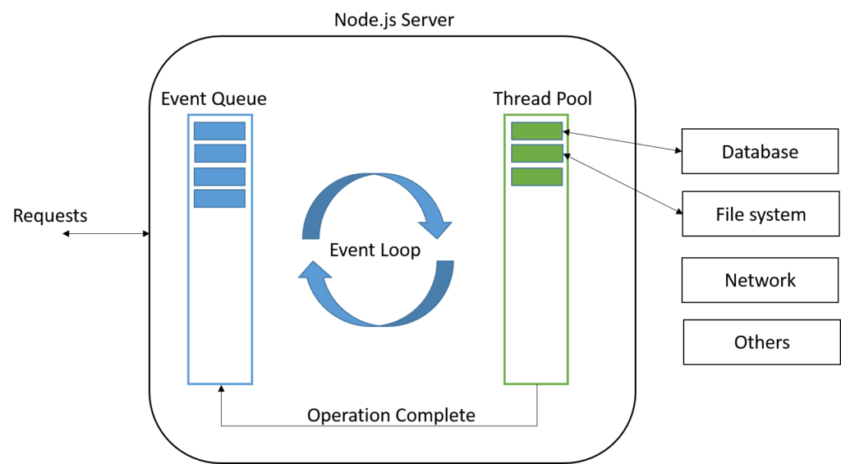

Slide 21
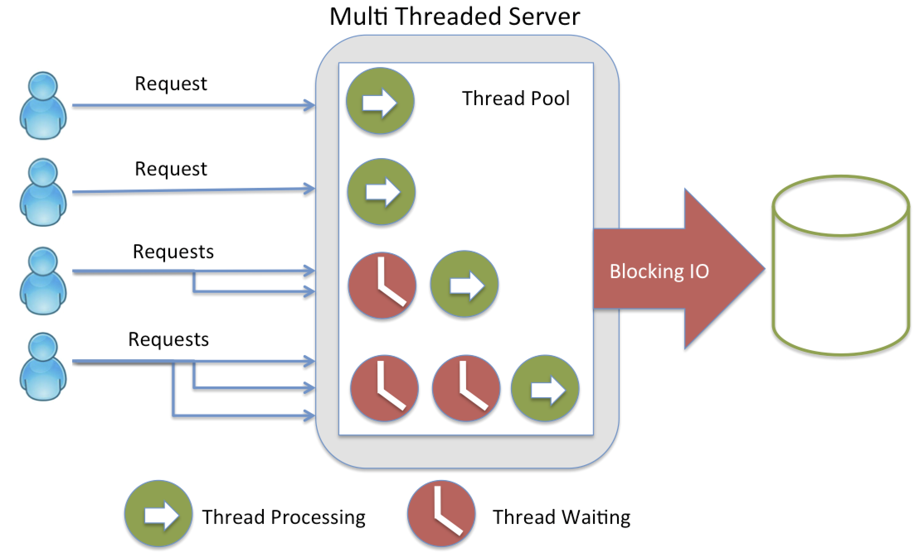

Slide 22
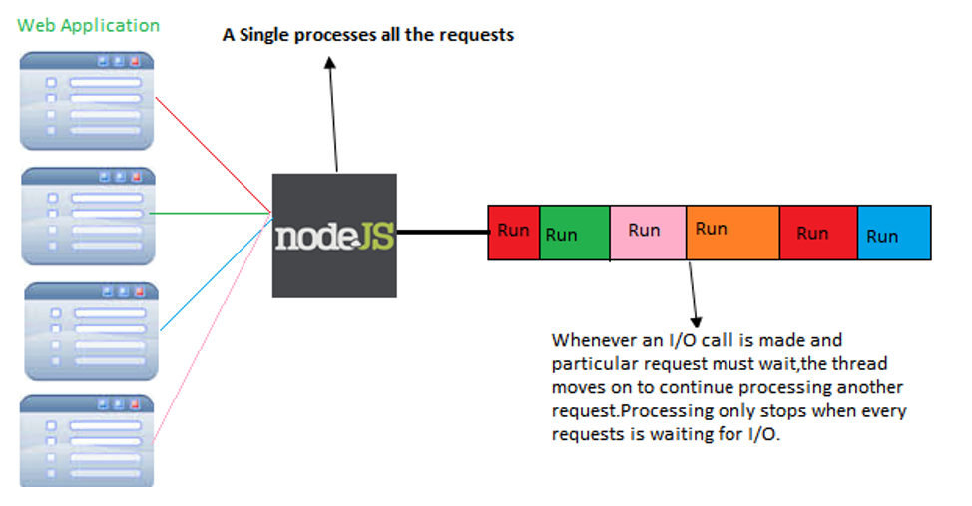

Slide 23
Node.js frameworks and tools
Node.js is a low-level platform.
To make things easier and more interesting for developers, thousands of libraries were built upon Node.js.
EXPRESS
One of the most simple yet powerful ways to create a web server.
Its minimalist approach and unopinionated focus on the core features of a server is key to its success.

Slide 24
Node.js frameworks and tools
Meteor
An incredibly powerful full-stack framework, empowering you with an isomorphic approach to building apps with JavaScript and sharing code on the client and the server.
Once an off-the-shelf tool that provided everything, it now integrates with front-end libraries such as React, Vue and Angular.
Meteor can be used to create mobile apps as well.

Slide 25
Node.js frameworks and tools
KOA
Built by the same team behind Express, Koa aims to be even simpler and smaller, building on top of years of knowledge.
The new project was born out of the need to create incompatible changes without disrupting the existing community.
Next.js This is a framework to render server-side rendered React applications.
Micro This is a very lightweight server to create asynchronous HTTP microservices.

Slide 26
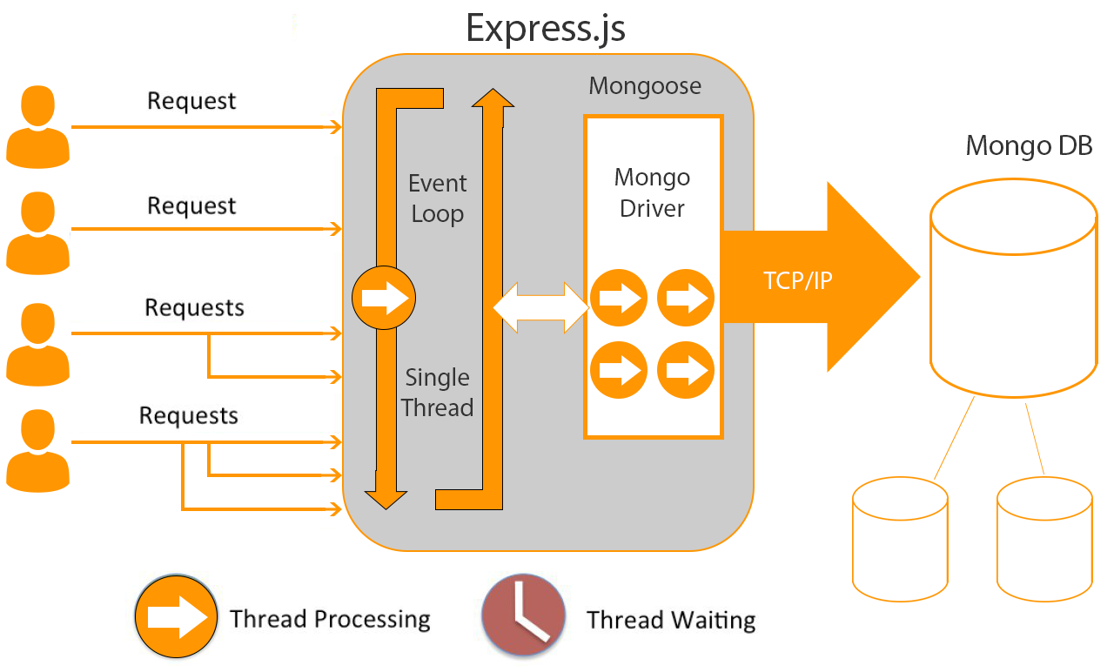

Slide 27
Differences between Node.js and the Browser
Building apps that run in the browser is a completely different thing than building a Node.js application.
Both the browser and Node use JavaScript as their programming language.
In the browser, most of the time what you are doing is interacting with the DOM, or other Web Platform APIs like Cookies. Those do not exist in Node.js
Don’t have the document, window and all the other objects that are provided by the browser.

Slide 28
Differences between Node.js and the Browser
Another big difference is that in Node.js you control the environment.
Know which version of Node.js will the application run on. Compared to the browser environment, where you don’t get the luxury to choose what browser your visitors will use, this is very convenient.
Can write all the modern ES6–7–8–9 JavaScript that your Node version supports.

Slide 29
Differences between Node.js and the Browser
Node.js uses the CommonJS module system, while in the browser we are starting to see the ES Modules standard being implemented.
use require() in Node.js and import in the browser.

Slide 30
V8 JavaScript Engine
V8 is the name of the JavaScript engine that powers Google Chrome.
It’s the thing that takes our JavaScript and executes it while browsing with Chrome.
V8 provides the runtime environment in which JavaScript executes. The DOM, and the other Web Platform APIs are provided by the browser.
The cool thing is that the JavaScript engine is independent by the browser in which it’s hosted.
This key feature enabled the rise of Node.js. V8 was chosen for being the engine chosen by Node.js back in 2009

Slide 31
Compilation
JavaScript is generally considered an interpreted language, but modern JavaScript engines no longer just interpret JavaScript, they compile it.
This happens since 2009 when the SpiderMonkey JavaScript compiler was added to Firefox 3.5, and everyone followed this idea.
JavScript is internally compiled by V8 with just-in-time (JIT) compilation to speed up the execution.

Slide 32
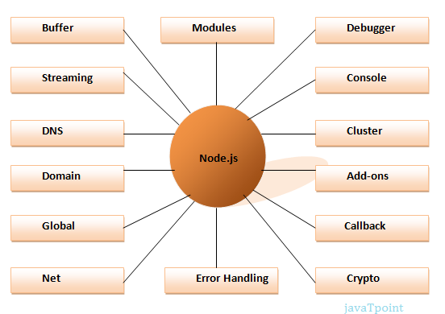
Different parts of Node.js

Slide 33
Node.js Development Environment
Node.js development environment can be setup in Windows, Mac, Linux and Solaris.
Tools/SDK are required for developing a Node.js application on any platform.
Node.js
Node Package Manager (NPM)
IDE (Integrated Development Environment) or TextEditor
NPM (Node Package Manager) is included in Node.js installation since Node version 0.6.0., so there is no need to install it separately.

Slide 34
Install Node.js on Windows
Visit Node.js official web site https://nodejs.org.
It will automatically detect OS and display download link as per Operating System. For example, it will display following download link for 64 bit Windows OS.
Download node MSI for windows by clicking on relevant button.
After you download the MSI, double-click on it to start the installation
Click Next to read and accept the License Agreement and then click Install.
It will install Node.js quickly on your computer.
Finally, click finish to complete the installation.

Slide 35
Verify Installation
Once you install Node.js on your computer, can verify it by opening the command prompt and typing node -v.
If Node.js is installed successfully then it will display the version of the Node.js installed on the machine,

Slide 36
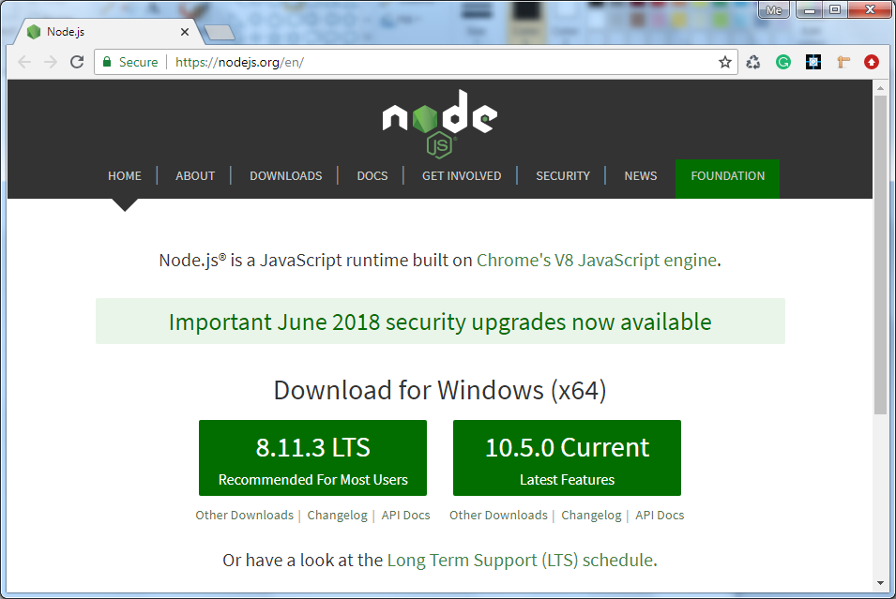

Slide 37
Event Loop
Allows processing of other tasks while IO calls are in the process.
Allows Node to be very fast and efficient because blocking I/O is expensive!
Event loop allows systems to be more effective because now you can do more things while you wait for your expensive input/output task to finish.

Slide 38
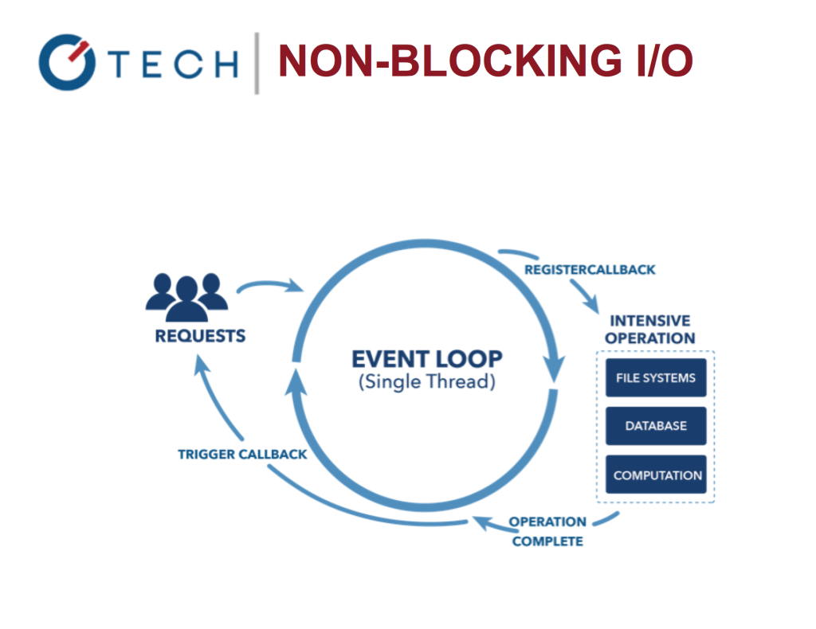

Slide 39
Guess the output
console.log('Step: 1')
setTimeout(function ()
{ console.log('Step: 3') }, 1000)
console.log('Step: 2')
Output of the Node script is 1, 2, 3, but if we had more statements after “Step 2”, they would have been executed before the callback of setTimeout.

Slide 40
Guess the output
console.log('Step: 1')
setTimeout(function () {
console.log('Step: 3')
console.log('Step 5') }, 1000);
console.log('Step: 2')
console.log('Step 4')
It produces 1, 2, 4, 3, 5. That’s because setTimeout puts it’s callback in the future cycles of the event loop.

Slide 41
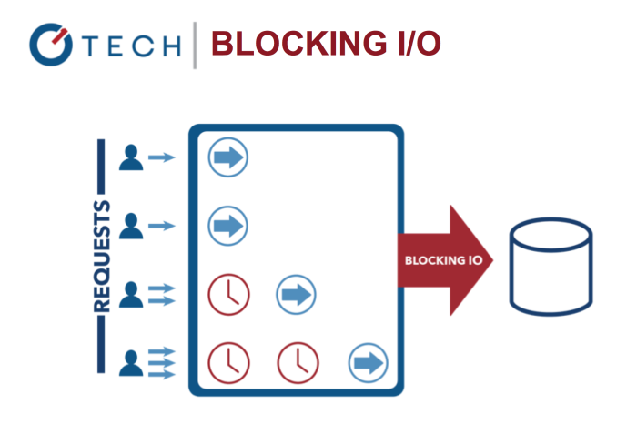

Slide 42
